Slide 1
SORTING

Slide 2
Lexicographically first palindromic string
Write a program to rearrange the characters of the given string to form a lexicographically first palindromic string. If no such string exists print “Not Possible”.
Example:
Input:
malayalam
Output:
aalmymlaa

Slide 3
Algorithm
Store frequency of each character
Check whether a palindromic string can be formed or not using the properties of palindromic string mentioned above.
If palindromic string cannot be formed, return “Not Possible”.
Else create three strings and then return front_str + odd_str + rear_str.
• odd_str: It is empty if there is no character with odd frequency. Else it contains all occurrences of odd character.
• front_str: Contains half occurrences of all even occurring characters of string in increasing order.
• rear_str: Contains half occurrences of all even occurring characters of string in reverse order of front_st

Slide 4
QuickSort
Follows the divide-and-conquer paradigm.
Divide: Partition (separate) the array A[p..r] into two (possibly empty) subarrays A[p..q–1] and A[q+1..r].
• Each element in A[p..q–1] < A[q].
• A[q] < each element in A[q+1..r].
• Index q is computed as part of the partitioning procedure.
Conquer: Sort the two subarrays by recursive calls to quicksort.
Combine: The subarrays are sorted in place – no work is needed to combine them.
How do the divide and combine steps of quicksort compare with those of merge sort?

Slide 5
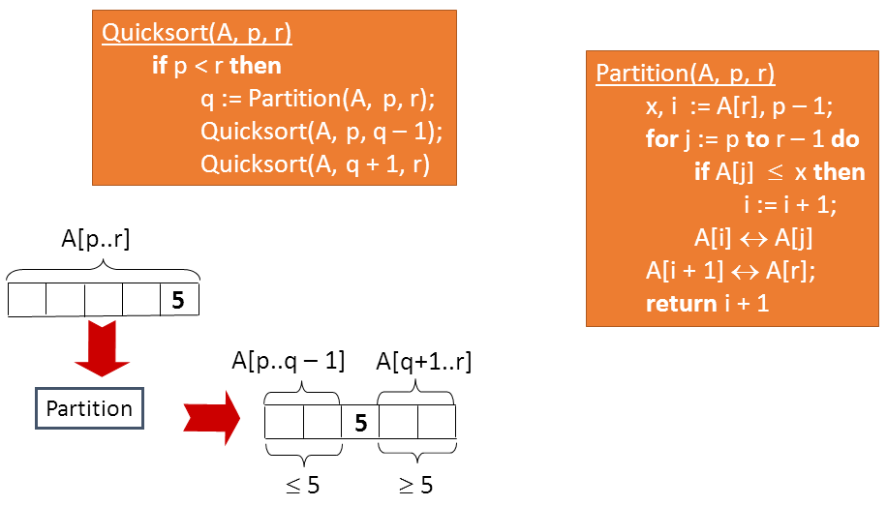
Pseudocode

Slide 6
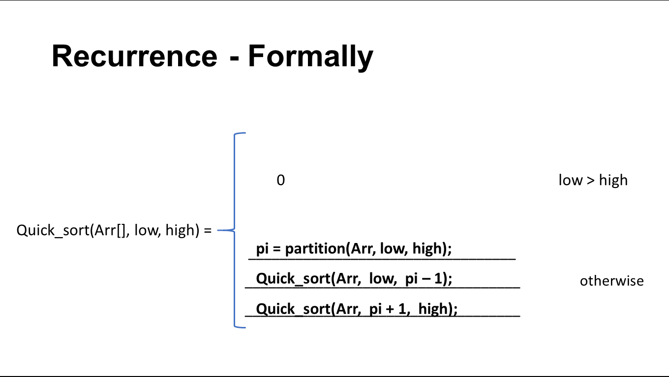
Recurrence - Formally

Slide 7
Selection Sort:
Selection sorting is one of the most simplest sorting algorithm.
STEPS:
➢ It first finds the smallest element in the array
➢ Exchanges it with the element in the first position,
➢ Then find the second smallest element and
➢ Exchange it with the element in the second position, and continues in this way until the entire array is sorted.

Slide 8
Selection Sort:
Selection sort is an unstable sort (i.e) it might change the occurrence of two similar elements in the list while sorting.
But it can also be a stable sort when it is implemented using linked list data structures.

Slide 9
Selection Sort:

Slide 10
Complexity Analysis of Selection Sorting:
Worst Case Time Complexity : O(n²)
Best Case Time Complexity : O(n²)
Average Time Complexity : O(n²)
Space Complexity : O(1)

Slide 11
Thank You …

